Slide 1
Connection Point 7
3D Printer Network

Slide 2
Current Technologies
The main connection technologies used in 3D printer models and connection methods

Slide 3
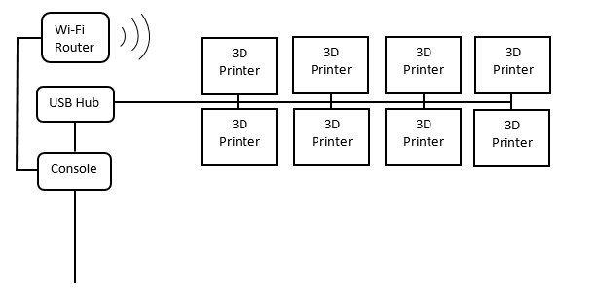
Proposed Design
The 3D printers will be connected to the console by a physical network of USB cabling and Hubs.
Suggest that a Wi-Fi router be installed as back up system in the event that there issues with the USB connection.

Slide 4
Specifications
Pros and Cons of proposed Solution

